Slide 1


Using Azure To Build Intelligent Bots
Eldert Grootenboer
Integration Architect

Slide 2
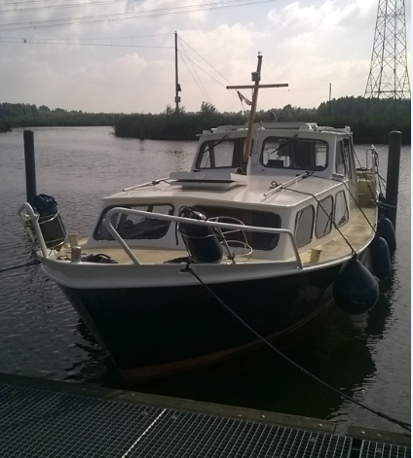
Eldert Grootenboer
@egrootenboer
Integration Architect
Microsoft Azure MVP
SME IoT
Blogger
Published Author
International Speaker
Global Integration Bootcamp
TechNet / MSDN
Boat enthusiast

Slide 3
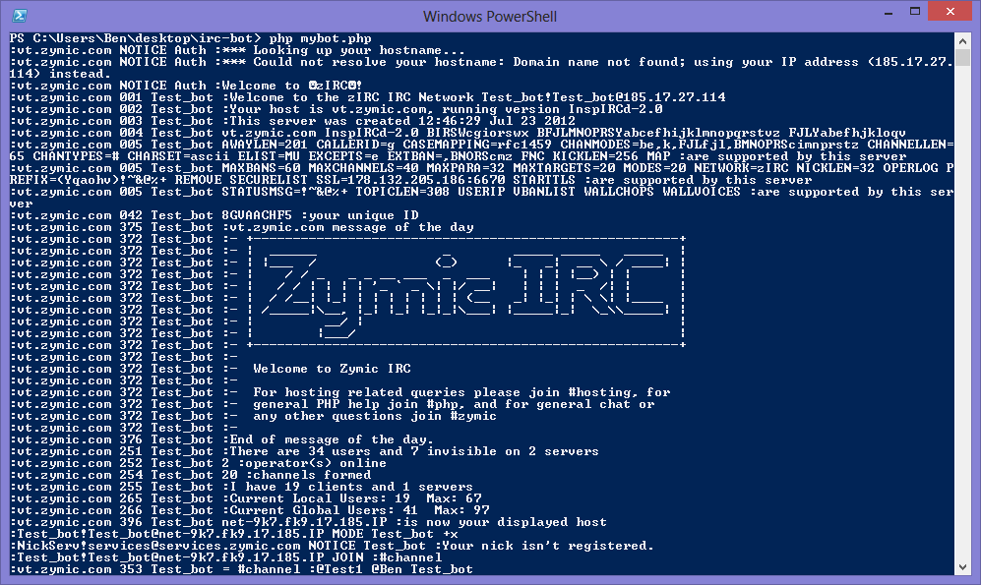
Bots

Slide 4




What is a Bot?
Platform
Platform Services
HTTP
AI
{ Your Code }
REST Endpoint
SDK
Intelligent Tools
Bot Builder SDK
REST Endpoint
Direct Line Protocol
Conversational and Business Logic
Canvas Aware
Context Sensitive

Slide 5



What is the Bot Framework?
What?
Tools for building REST Web Sites
Services to enrich
Mechanisms for receive events
Data to debug and analyze
Customer’s
Business Logic & Data
Bot Connector
Why?
Implements standard protocols
Modeling conversations is hard. Tools help!
UI across multiple canvases is hard. Cards rock!
Language Understanding is hard
Common and well understood patterns
C#
BOT BUILDER
Bot Controls
Skype
Bing
Web Chat
Goals
Start Simple. Add Complexity. No dead-ends.
Bot adapts to the user, based on context
Composable and intelligent controls to manage complexity
LUIS
Form Filling
QnA
Skype for Business
Cortana
Direct Line
Query over database via Azure Search
3rd Party

Slide 6
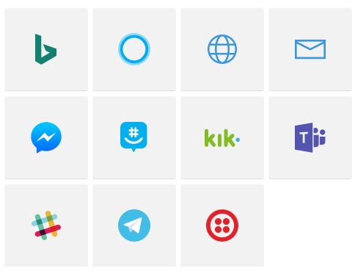
Channels

Slide 7
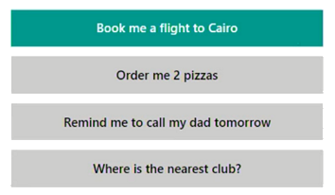
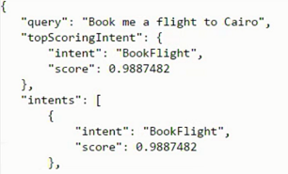

LUIS
Notes:
Customs
Caterpillar die service contract aanbied op schepen

Slide 8
Dialog
[Serializable]
public class EchoDialog : IDialog<object>
{
public async Task StartAsync(IDialogContext context)
{
context.Wait(MessageReceivedAsync);
}
public async Task MessageReceivedAsync(IDialogContext context, IAwaitable<IMessageActivity> argument)
{
var message = await argument;
await context.PostAsync("You said: " + message.Text);
context.Wait(MessageReceivedAsync);
}
}

Slide 9
FormFlow
public string NameOfVessel;
[Numeric(1000000, 9999999)]
[Prompt("Please enter your {&}")]
public int OfficialVesselNumber;
[Pattern(@"^(?:\+\d{1,3}|0\d{1,3}|00\d{1,2})?(?:\s?\(\d+\))?(?:[-\/\s.]|\d)+$")]
public string PhoneNumber;
[Numeric(2, 20)]
[Prompt("Please enter the {&}")]
public int NumberOfPeopleOnBoard;
public Cargo? PreviousCargo;
public static IForm<ShipRegistrationDialog> BuildForm()
{
return new FormBuilder<ShipRegistrationDialog>().Message("Welcome to Rotterdam Tank Terminals").OnCompletion(StartStoreRegistration).Build();
}

Slide 10
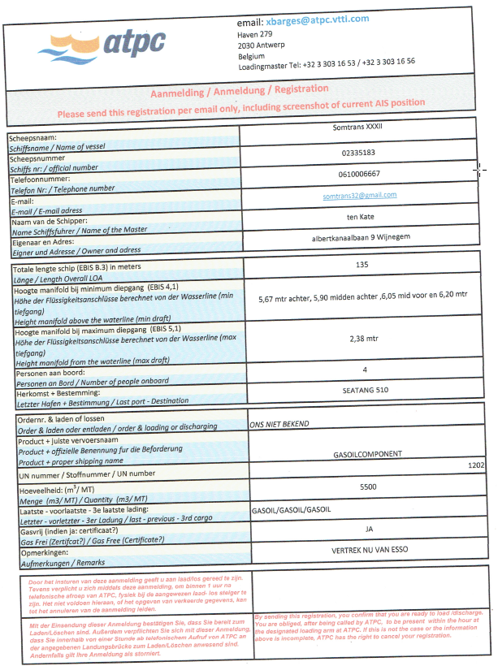
Scenario
Notes:
Ship emails registration
Operator has to pick it, check if the ship is actually near and in the system
Operator types over from registration form
Operator calls ship, where captain might be sleeping

Slide 11
Demo
Notes:
Register ship in skype, including invalid values and help
Show code for controller and dialogs
Show registered bot
Show LUIS
Approve registration
Somtrans X wants to register for loading

Slide 12
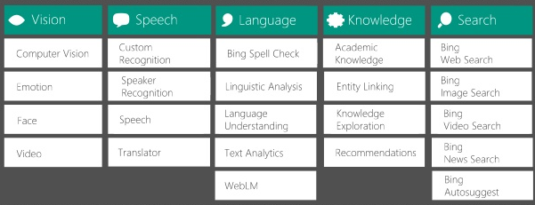
Cognitive Services

Slide 13
Demo
Notes:
Status of registration, show in dutch and german
Show Logic App with translation
Show run details
Wat is de status van registratie nummer 5?
Jaký je stav registračním číslem 7?

Slide 14
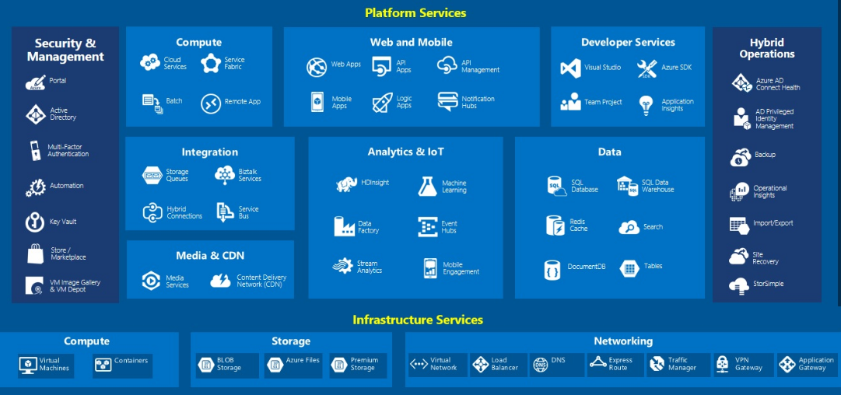
Extend With Azure

Slide 15



Advanced Workflows
Notes:
Place logic outside bot

Slide 16
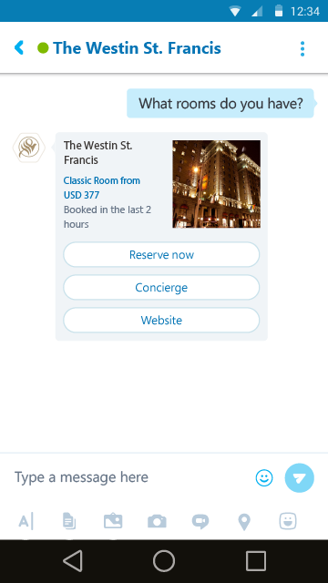
Hero Cards

Slide 17
Initiate Conversation From Bot
var initiatingServiceUri = (string)brokeredMessage.Properties["InitiatingServiceUri"];
var initiatingUserId = brokeredMessage.Properties["InitiatingUserId"] as string;
var initiatingUserName = brokeredMessage.Properties["InitiatingUserName"] as string;
var userAccount = new ChannelAccount(initiatingUserId, initiatingUserName);
var connector = new ConnectorClient(new Uri(initiatingServiceUri));
var conversationId = await connector.Conversations.CreateDirectConversationAsync(botAccount, userAccount);
var messageActivity = Activity.CreateMessageActivity();
await connector.Conversations.SendToConversationAsync((Activity)messageActivity);

Slide 18
Demo
IMO
Notes:
Process registration
Hello
Logic App retrieves open registrations
Logic App retrieves IMO (sample database)
Logic App retrieves ship position, call bing maps and save map image
Logic App retrieves ship information from CRM
Optional: Logic App retrieves ship information and stores it in CRM
Show Logic Apps
Show emails
Show appointment
Show

Slide 19
Key Takeaways
Build Bots Easily
Bot Framework gives an easy way to create interactive, context aware bots
Customizable
Create custom dialogs and messages
Extendable
Integrate with Azure services by calling Logic Apps
Notes:
Bots allow us an interactive frontend to our data

Slide 20




Thank You
@egrootenboer
eldert.grootenboer@motion10.com
http://blog.eldert.net/
http://blogs.biztalk360.com

Slide 21




Think
Share
Move

